Slide 1

Working With AI Tools
Session – 2

Slide 2
Agenda
Critical Thinking
Cognitive Biases and Mental Traps
Evaluating Claims and Techniques
Logical Reasoning and Fallacies
Critically Evaluating AI Output
Case Studies

Slide 3
Critical Thinking
Though of Clarity

Slide 4
Critical Thinking of AI Content
When applied to AI-generated content, the traditional pillars of critical thinking undergo a unique shift. AI can produce text that looks polished, but it lacks human consciousness and intent.
Evaluating AI output against clarity, accuracy, relevance, and logic is your primary defense against machine bias, hallucinations, and surface-level analysis.

Slide 5

The Framework
Accuracy and Clarity

Slide 6

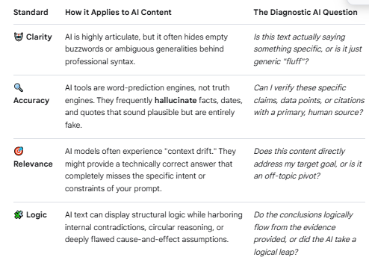
Critical Thinking – The Framework

Slide 7
AI Fluency
When machines can generate convincing language instantly, the human role shifts from creator to editor, auditor, and ultimate judge.
AI fluency—the ability of large language models to generate highly polished, authoritative, and grammatically flawless prose—creates a psychological illusion of competence.
Because the output sounds like it was written by an expert, human brains naturally drop their cognitive guard. This makes independent judgment more critical than ever before.

Slide 8
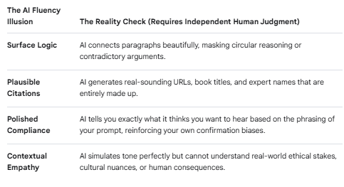
In human psychology, we often equate eloquence with expertise. AI exploits this shortcut. An AI model can state a complete fabrication with the exact same confidence, tone, and sentence structure as a verified medical fact.
Without independent judgment, humans fall victim to automation bias: the tendency to trust automated systems even when they contradict human logic or reality.
The Danger of Fluency Bias

Slide 9

4 Step Claim Audit Framework
1. 🛑 Stop (Check Your Bias & Tone)
Before processing the information, pause. Fluently written text or emotionally charged claims trick our brains into instant agreement.
The Question: Am I believing this just because it sounds professional, or because it aligns with what I already want to be true?
The Action: Treat the claim as a hypothesis, not a fact.

Slide 10
2. 🔍 Investigate the Source
Look into who or what is making the claim.
The Question: What is the track record, expertise, or motive of the creator (human or AI engine)?
The Action: If it is an AI, remember it is a word-predictor, not a truth-engine. If it is a human, check if they are an expert in this specific field or just a loud voice.

Slide 11
3. 🎯 Find Trusted Coverage
Look for a consensus or alternative perspectives. Never rely on a single piece of output to form a judgment.
The Question: Do other independent, reputable sources confirm this exact data point or conclusion?
The Action: Perform a quick lateral search. Look up the core claim elsewhere rather than just reading the text provided.
4. 🪓 Trace Claims to the Original Context
Claims are often distorted when summarized, clipped, or generated by an AI model.
The Question: What did the original study, quote, or data point actually say before it was repackaged?
The Action: Click the embedded links, look up the cited case, or demand the primary source. If the source doesn't exist, drop the claim.

Slide 12

Cognitive Bias & Mental Traps
Confirmation Bias
Anchoring Bias
Automation Bias
12

Slide 13
3 Critical Mental Maps
1. Confirmation Bias: The Reality Filter
What it is: The deeply ingrained human tendency to search for, interpret, and recall information in a way that confirms our pre-existing beliefs or hypotheses, while completely ignoring contradictory evidence.
2. Anchoring Bias: The First-Impression Lock
What it is: The cognitive tendency to rely too heavily on the first piece of information encountered (the "anchor") when making decisions, even if that information is arbitrary or inaccurate.
3. Automation Bias: The Illusion of Mechanical Infallibility
What it is: The psychological tendency to over-trust automated systems simply because "the computer said so." Humans naturally attribute a higher level of objectivity, neutrality, and mathematical truth to machines than to other humans.

Slide 14
How to Break the Traps: A De-Biasing Toolkit
To maintain independent judgment, you must actively deploy mental counter-measures:
To fight Confirmation Bias: Actively prompt the AI to argue against your conclusion. Ask: "What is the strongest, data-backed counterargument to the point above?"
To fight Anchoring Bias: Before looking at any AI output, write down your own independent thoughts, baseline numbers, or structural outline on a physical notepad. Use your own human logic as the anchor.
To fight Automation Bias: Adopt the mindset of a strict editor or auditor. Assume the AI is an incredibly articulate intern who is highly eager to please but occasionally makes things up. Never copy-paste without external verification.
14

Slide 15
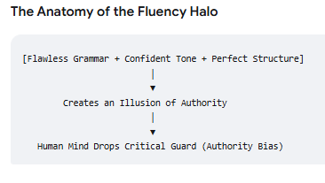
Authority Bias
Authority bias is our natural tendency to value the opinion of an authority figure or a highly formal source over our own logic.
When applied to AI, this creates the "Fluency Halo Effect." Because an AI outputs structured paragraphs, flawless grammar, bullet points, and an unshakeable tone of absolute certainty, it mirrors the posture of an elite expert. Our brains mistake this confident delivery for actual truth, creating a psychological blind spot where we accept falsehoods simply because they sound authoritative.

Slide 16
Practical Habits to Counter Each Mental Trap
To keep your independent judgment sharp, you must replace passive reading with active defense mechanisms. Here is how to counter the five major cognitive traps we have discussed.
1. Countering Authority Bias & The Fluency Halo
The Trap: Believing the output because it reads like a Harvard textbook or a professional brief.
The Habit: "Strip the Suit." Imagine the exact same text was written on a napkin in messy handwriting by a chaotic classmate. Does the argument still hold up when stripped of its beautiful formatting and confident adjectives? If you remove the "corporate speak," you often find the underlying logic is thin or circular.
2. Countering Automation Bias
The Trap: Trusting the data or analysis blindly because "the algorithm calculated it."
The Habit: The Articulate Intern Persona. Mentally reframe the AI. Do not treat it as an oracle or an infallible supercomputer. Treat it as a highly articulate, incredibly fast, 19-year-old intern who is eager to please you but occasionally makes things up completely when they don't know the answer. You would never turn in an intern's draft to your boss without reviewing every line; treat AI text the same way.

Slide 17
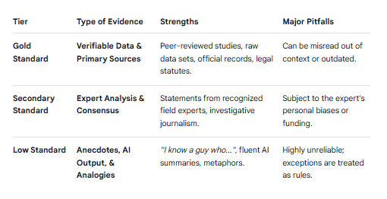
Evaluating Claims & Evidence
To evaluate any claim or piece of evidence effectively—whether it comes from a human expert, a news outlet, or an AI model—you must look past how the information is delivered and focus entirely on what supports it.
The core of independent judgment relies on a structural evaluation of the connection between a claim (the statement being made) and the evidence (the data, facts, or logic backing it up).

Slide 18

The verification Pillars

Slide 19
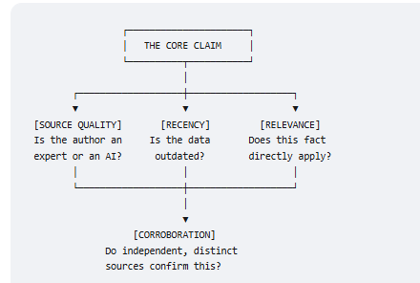
The Verification Pillars: Quality, Recency, Relevance, and Corroboration
Evaluating claims requires a disciplined approach to auditing the foundation of information. You must assess the individual integrity of a source and verify its claims through a network of independent validation.
19

Slide 20
-Triangulating Source Quality, Recency, and Relevance
Before reading a text or accepting data, run the source through three specific diagnostic filters.
1. Source Quality: Auditing Expertise vs. Fluency
The Core Principle: A high-quality source possesses verified, specialized expertise and a track record of accountability.
The Hazard: Confusing high production value (slick web design, authoritative graphics, fluent AI prose) with actual authority.
2. Recency: Tracking the Expiration Date of Truth
The Core Principle: Facts have a shelf life. Information that was perfectly accurate five years ago may be completely wrong today due to new discoveries, policy shifts, or technological evolution.
The Hazard: AI models operating on a static training dataset frequently treat outdated past laws, market data, or scientific paradigms as current reality.

Slide 21
Corroboration
Part 2: Corroboration—The Power of Cross-Checking
Corroboration is the practice of comparing a claim against multiple independent sources to see if they agree. It is the single most powerful defense against disinformation, human error, and AI hallucinations.
True corroboration requires finding pieces of evidence that do not share the same origin point.

Slide 22
Distortions of AI Evidence
When evaluating evidence or data generated or summarized by an AI model, spotting missing context, cherry-picking, and misleading framing requires a hyper-specific lens. AI does not manipulate information out of malice or personal bias; instead, it manipulates text based on mathematical optimization, prompt compliance, and text-compression constraints.

Slide 23
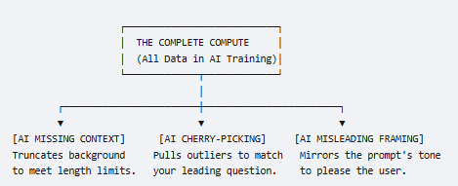
AI Missing Context: The Compression Trap
Why the AI does it: Large Language Models (LLMs) are bound by token constraints (length limits) and are optimized for conciseness. When asked to summarize a 50-page document or a complex topic, the AI aggressively discards nuances, local exceptions, and foundational history to deliver a clean, brief response.
How it looks in AI evidence: The AI states a flat fact or trend line without mentioning the unique environment that made it possible.

Slide 24
AI Cherry Picking Trap
2. AI Cherry-Picking: The Sycophancy Trap
Why the AI does it: AI models suffer from sycophancy—a built-in algorithmic tendency to tell the user what they want to hear based on the structure of the prompt. If you ask a biased question, the AI will comb its vast database to compile only the data points that satisfy your bias, ignoring the wider consensus.
How it looks in AI evidence: The AI presents an absolute, one-sided list of statistics that perfectly validates a narrow viewpoint, masking it in a highly professional tone.

Slide 25
AI Misleading Framing
3. AI Misleading Framing: The Persona Mirror
Why the AI does it: AI seamlessly adopts whatever stylistic tone, emotional register, or analytical frame you establish in your prompt. If you ask it to analyze a neutral corporate report "as a skeptical investor," it will frame ordinary expenses as catastrophic failures.
How it looks in AI evidence: The AI uses loaded adjectives ("drastic decline," "unprecedented leap") to describe statistically minor variations, creating a narrative arc out of flat data.

Slide 26
AI Logical Reasoning and Fallacies
When evaluating the logical reasoning of an AI model, we must look past its fluent language and dissect its argument structure.
AI tools are built on neural networks that predict the next most likely word; they do not possess a conscious mind that understands human logic. As a result, they can easily construct arguments that look perfectly structured but are fundamentally broken underneath

Slide 27
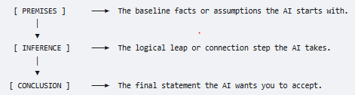
Three Core Components of AI Argument
The Premises: These are the foundational claims, data points, or assumptions the AI presents as truth. In an AI model, premises come from two places: your prompt or its own training data.
The Inference: This is the cognitive bridge. It is the step-by-step reasoning process the AI uses to connect its starting premises to its final point.
The Conclusion: The final claim or decision arrived at by the AI.

Slide 28
Validity & Soundness of AI output
The most dangerous trait of fluent AI is its ability to generate arguments that are completely valid but entirely unsound.
Validity is about the structure of the argument. An argument is valid if the conclusion must follow logically from the premises, regardless of whether those premises are actually true in the real world.
Soundness is about the truth of the argument. An argument is sound only if it meets two criteria: the logical structure is valid AND all the underlying premises are factually true.

Slide 29
Common Fallacies
A fallacy is an error in reasoning that renders an argument invalid or unsound.
When processing highly fluent content, four specific fallacies frequently mask weak points behind a veneer of persuasiveness: false cause, straw man, false dilemma, and appeal to authority

Slide 30
AI Fallacies
1. Post Hoc Ergo Propter Hoc (False Cause)
The Flaw: Assuming that because Event B occurred after Event A, Event A must have caused Event B.
Why AI Does It: AI models excel at spotting correlations but struggle to prove actual causation. If two trends appear together in its training data, the AI will fluently write a narrative linking them as cause and effect.

Slide 31
2. Circular Reasoning (Begging the Question)
The Flaw: An argument where the premise is identical to the conclusion. The proof relies completely on the claim itself.
Why AI Does It: When compressed by length limits, an AI often runs out of substantive data points and fills space by restating your prompt in different words to appear thorough.
The AI Presentation: "Our proprietary algorithm is highly reliable because it uses a state-of-the-art diagnostic system that consistently delivers dependable results." (It is reliable because it is dependable).
3. The False Dichotomy (Black-and-White Thinking)
The Flaw: Presenting a complex issue as a rigid choice between only two extreme options, completely ignoring the nuanced middle ground.
Why AI Does It: AI models are often trained to optimize for clear, categorized answers. It is algorithmically simpler for an LLM to pit two opposing concepts against each other than to balance a spectrum of overlapping variables.

Slide 32
4. The Bandwagon Fallacy (Ad Populum)
The Flaw: Arguing that a claim or solution is correct simply because a large number of people or organizations believe or use it.
Why AI Does It: LLMs operate on statistical popularity within their training data. If a specific framework or buzzword appears millions of times on the internet, the AI defaults to treating it as the definitive best practice.
The AI Presentation: "90% of Fortune 500 companies use Framework X for their data logistics. Therefore, Framework X is the most secure and optimal tool for your local retail business.

Slide 33
Why AI Models Can Be Confincingly Wrong: The Mechanics of Deception
Large Language Models (LLMs) do not possess a database of facts or a conscious understanding of reality. Instead, they are advanced statistical text-prediction engines.

Slide 34
1. Hallucination: The Compulsive Word Predictor
What it is: The generation of text that sounds coherent and persuasive but is completely detached from factual reality or the input source.
Why it happens: AI is optimized to prioritize fluency and answer completeness over saying "I don't know." If a model encounters a gap in its pattern-matching network, it statistically invents a plausible-sounding filler point. Because it treats a fake fact with the same mathematical confidence as a real one, the tone remains unshakeable.
The Manifestation: Inventions of legal precedents, fake historical events, or non-existent software parameters that look perfectly authentic.
2. Outdated Knowledge: The Static Worldview
What it is: The structural inability of a base model to account for real-time events, changing regulations, or new data discovered after its training cutoff date.
Why it happens: Base AI training is static and requires massive compute power. A model completed in early 2024 remains perpetually frozen in that exact moment in time unless paired with a live search engine.
The Manifestation: Providing expired tax codes, quoting bankrupt corporate structures as thriving, or ignoring breakthrough research papers published last month.

Slide 35
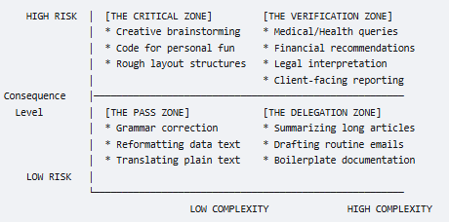
The Friction of Verification: Balancing Speed and Skepticism
Critical thinking does not require you to treat every single sentence an AI outputs as a high-stakes crisis. If you fact-check every comma, you destroy the primary benefit of using AI: efficiency.
To maintain independent judgment without sacrificing speed, you must classify tasks into a Risk Matrix.

Slide 36
The Verification Zone (High Risk, High Complexity)
The Threshold: If the AI output is wrong, it could result in financial loss, legal liability, physical harm, or severe reputational damage.
The Strategy: Zero-Trust Auditing. Run the full 3-layer fact-checking protocol. Trace every statistic, citation, and legal claim to a primary human source outside the AI interface.
2. The Critical Zone (High Risk, Low Complexity)
The Threshold: The content is simple, but the impact of an error is still high (e.g., an address, an application deadline, or an API key endpoint).
The Strategy: Spot Verification. You don't need to check the logic, but you must double-check the raw factual tokens (numbers, dates, names) using a quick lateral search.
3. The Delegation Zone (Low Risk, High Complexity)
The Threshold: Complex structural tasks where a minor factual error will be caught downstream or has minimal real-world blowback (e.g., summarizing an industry trend article for personal background reading).
The Strategy: Structural Sanity Check. Ensure the AI's logic flows smoothly and it hasn't fallen into a circular reasoning loop, but skip primary source tracing.

Slide 37

Shift in Stance: Capable Assistant, Not an Authority
To insulate yourself from authority bias and the fluency halo, you must fundamentally reframe your relationship with the machine.

Slide 38
Rules for Human AI Hierarchy
Rule 1: You Hold the Liability, You Hold the Crown
An AI cannot sign a contract, lose a job, or stand in a courtroom. Because you inherit 100% of the real-world consequences of the text, you must retain 100% of the editorial control. Never let an AI make the final strategic choice.
Rule 2: Outsource the Labor, Never the Logic
Let the AI perform the heavy lifting: formatting data, parsing long PDFs, generating initial drafts, or writing boilerplate code. However, you must provide the core premise, evaluate the inferences, and validate the final conclusion.
Rule 3: Frame the Persona Explicitly
If you treat the AI as an oracle, it will mimic one. Instead, use your prompting structure to ground its position.

Slide 39
Questions

